Slide 1

Today’s Program
Construction Update
A look at Mission Bernal
Video
Fun Quiz
Staff Recognition
Community Benefit Highlight
Drawings!
FALL 2017
CEO
TOWN HALL
with Dr. Warren Browner, CEO
and Shannon Thomas, Director of Nursing
& Site Leader
Notes:
STL
CAL Diane Petruzzella – VP of Surgical Services
Davies Mary Lanier – CAO
PAC Ameet Nanda – SA/VP
STL Shannon Thomas – Director of Nursing

Slide 2
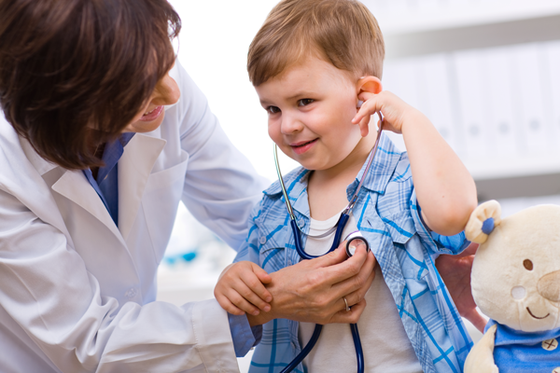

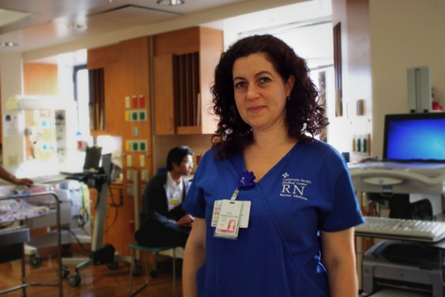

Our CPMC2020 Themes
erformance
are
C
P
e
M
C
ommunity
Notes:
Just a quick reminder re our CPMC2020 themes.
More than just bricks and mortar: 4 Themes moving forward

Slide 3
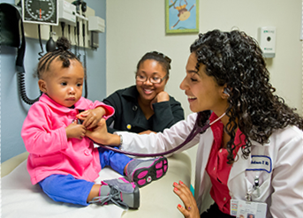
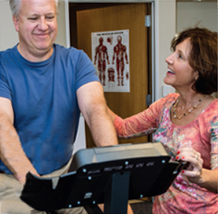
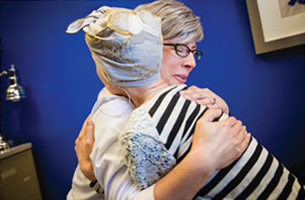
Care
Performance
Me
Community

Slide 4

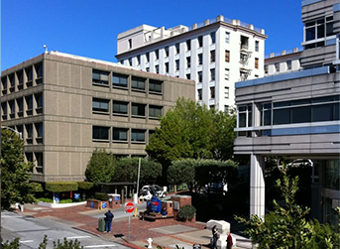
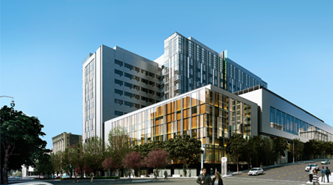

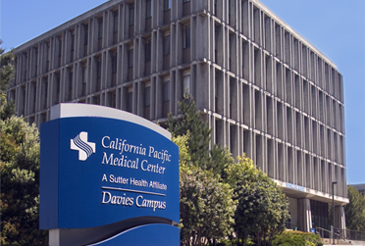
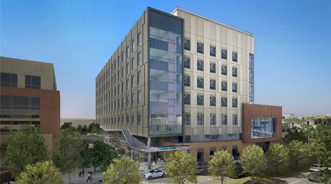
PACIFIC HEIGHTS Outpatient Only
CPMC2020: The Big Picture
Van Ness 274 Acute Beds
519 TOTAL
Licensed Acute BEDS
DAVIES 125 Acute & Rehab Beds
Mission bernal 120 Acute Beds

Slide 5
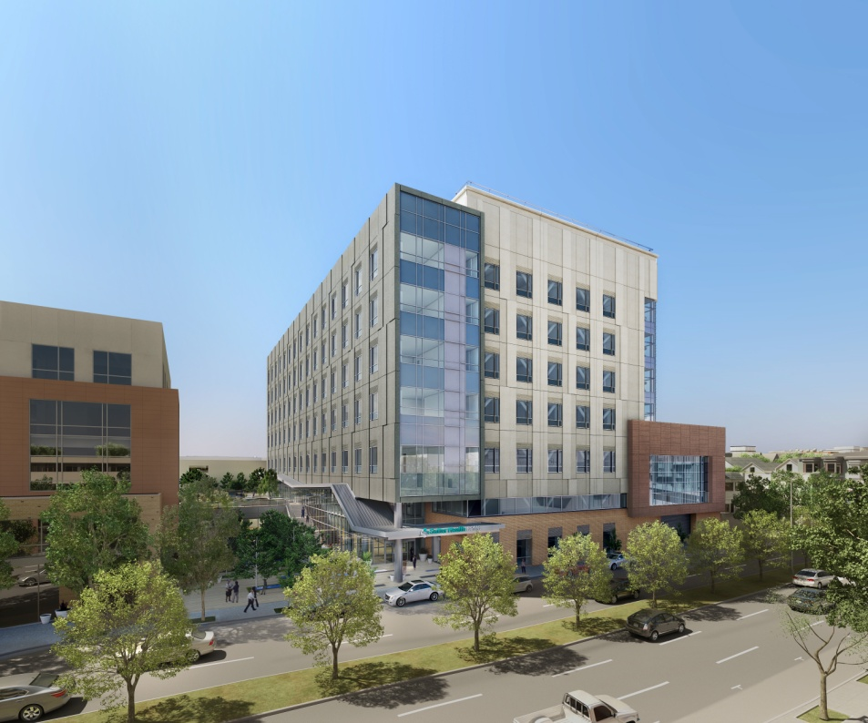
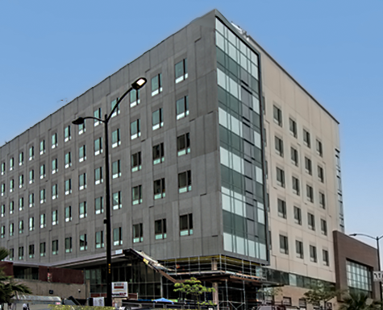
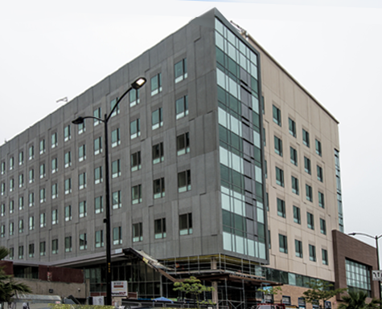
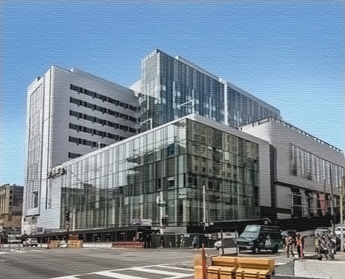
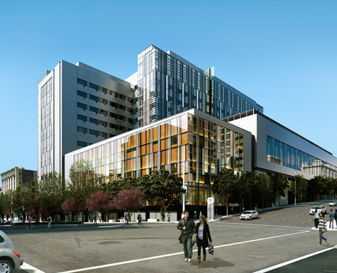
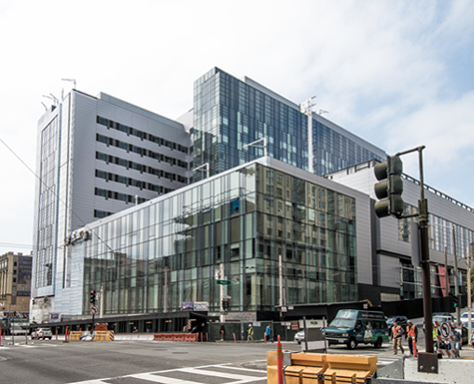
Construction Updates
75% complete
Construction Complete: August 2018
Patient Occupancy: March 2019
85% Complete
Construction Complete: May 1, 2018
Patient Occupancy: Late August 2018
Which is the Actual photo?
Mission Bernal campus
Van Ness campus

Slide 6

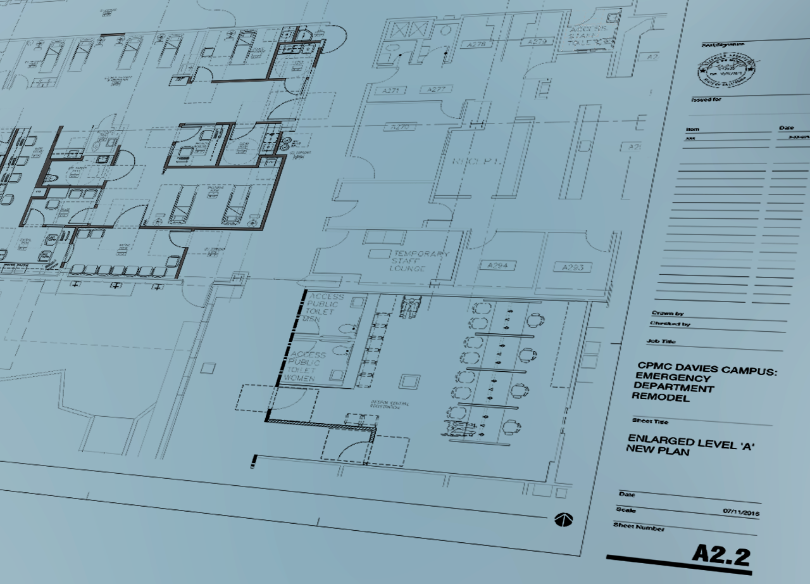
Davies Construction
Construction Updates
Planned:
ASU relocation from 4N to A Level next to ORs in N. Tower
Behavioral Health relocation from Pac to 2S/3S
SNF ADA Upgrades
eICU relocation from Folsom
Underway:
New Conference Center-S. Tower Fall 2017
ADA-upgraded patient rooms December 31, 2017
Pathology Dept relocation June 2018
ED expansion December 2018
Seismic upgrade of N. Tower December 2018
75% complete
Construction Complete: August 2018
Patient Occupancy: March 2019
Notes:
Here are just some of the many construction projects going at Davies – some underway now, some in the planning phase

Slide 7
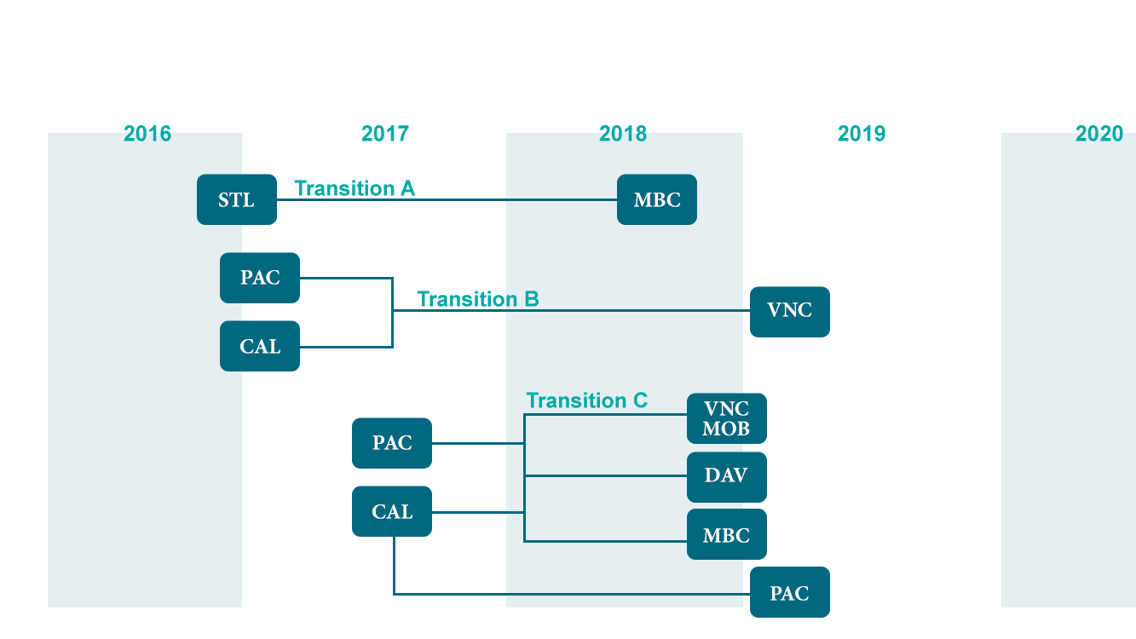
Transition Timeline
2017
2018
2019
2020
STL
MB
PAC
VN
CAL
VN MOB
PAC O/P
PAC
CAL O/P
MB
DAV

Slide 8
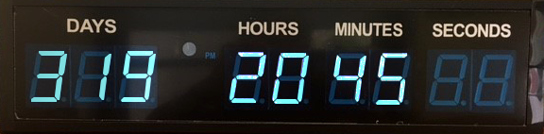
A look at Mission Bernal
Less than a year until we open!
Timeclock now on mySutter Intranet
Notes:
• Mission Bernal – scheduled to open August 2018- less than a year out
• The first of our new hospitals – so today, we want to give you a more detailed look.
• Acknowledge that many in audience may work elsewhere, but we are part of a whole – and a lot of what we’ll be doing at MB we will do at VN
(ST Lukes) – 319 Days to Aug 25th Opening.

Slide 9

A look at Mission Bernal
Less than a year until we open!
Timeclock now on mySutter Intranet
Notes:
• Mission Bernal – scheduled to open August 2018- less than a year out
• The first of our new hospitals – so today, we want to give you a more detailed look.
• Acknowledge that many in audience may work elsewhere, but we are part of a whole – and a lot of what we’ll be doing at MB we will do at VN
(Cal) – 318 Days to Aug 25th Opening.

Slide 10
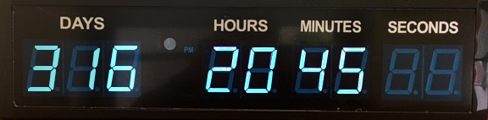
A look at Mission Bernal
Less than a year until we open!
Timeclock now on mySutter Intranet
Notes:
• Mission Bernal – scheduled to open August 2018- less than a year out
• The first of our new hospitals – so today, we want to give you a more detailed look.
• Acknowledge that many in audience may work elsewhere, but we are part of a whole – and a lot of what we’ll be doing at MB we will do at VN
(Davies) – 316 Days to Aug 25th Opening.

Slide 11
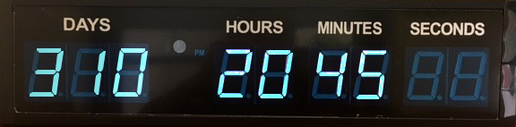
A look at Mission Bernal
Less than a year until we open!
Timeclock now on mySutter Intranet
Notes:
• Mission Bernal – scheduled to open August 2018- less than a year out
• The first of our new hospitals – so today, we want to give you a more detailed look.
• Acknowledge that many in audience may work elsewhere, but we are part of a whole – and a lot of what we’ll be doing at MB we will do at VN
(Pac 2) – 310 Days to Aug 25th Opening.

Slide 12
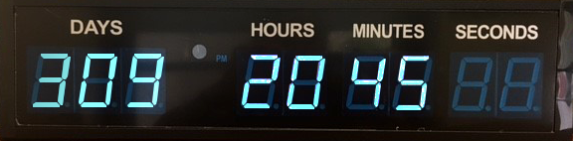
A look at Mission Bernal
Less than a year until we open!
Timeclock now on mySutter Intranet
Notes:
• Mission Bernal – scheduled to open August 2018- less than a year out
• The first of our new hospitals – so today, we want to give you a more detailed look.
• Acknowledge that many in audience may work elsewhere, but we are part of a whole – and a lot of what we’ll be doing at MB we will do at VN
(Pac 2) – 309 Days to Aug 25th Opening.

Slide 13
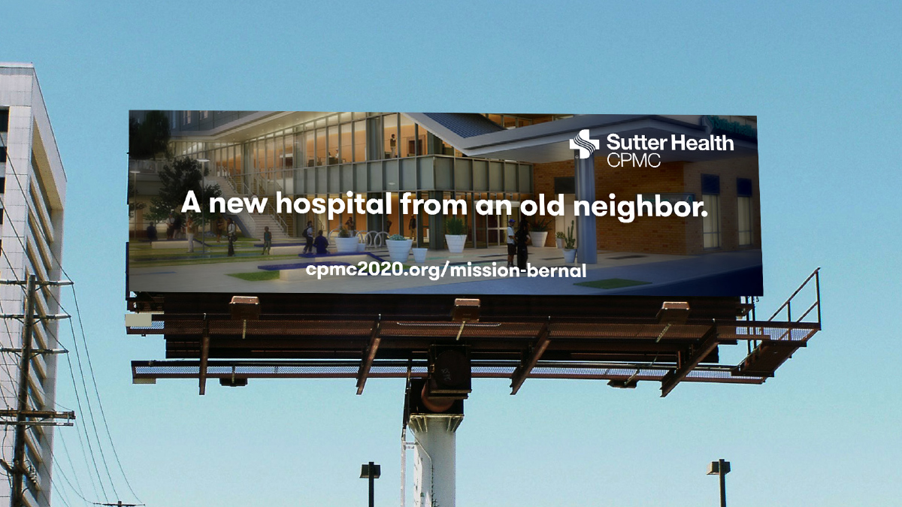
Introducing... CPMC Mission Bernal

Slide 14
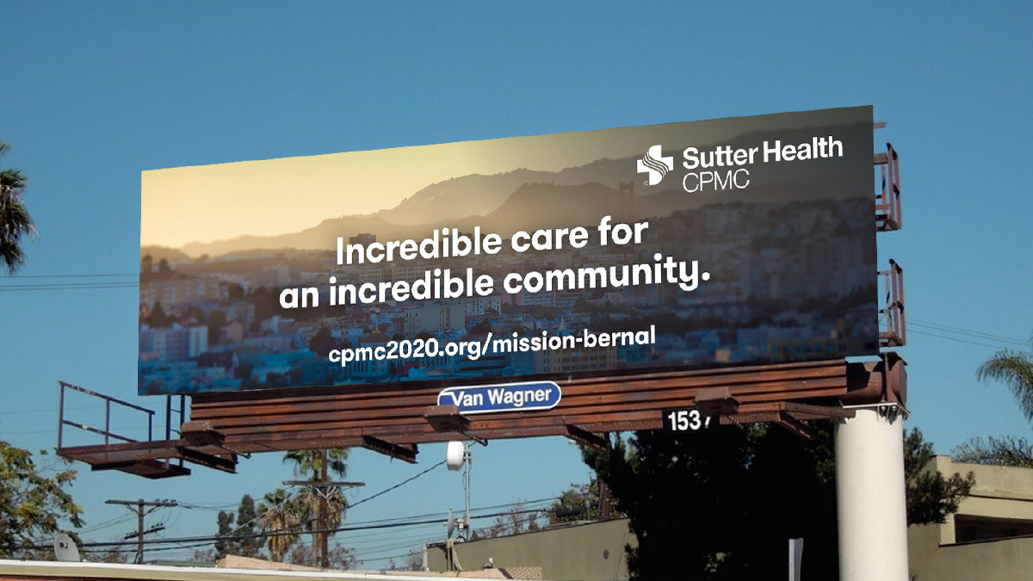
Introducing... CPMC Mission Bernal

Slide 15
Mission Bernal: Services I
Medical Services
Critical Care
General Medicine
Geriatrics
Medical Sub-Specialties
Surgical Services
ENT
General & Vascular Surgery
Gynecology
Ophthalmology
Orthopedics
Urology
Obstetrics
Notes:
For STL – Most of you will move right next door.

Slide 16
Mission Bernal: Services II
Additional Patient Services
Emergency
Antepartum Testing
Breast Health
Cardiac Rehab
Chapel
Diabetes Center
Non-Invasive Cardiology
Lab/Pathology
Newborn Connections
Pulmonary Function Lab
Pulmonary Rehab
Specialty Clinic & HCC
Radiology
Support/Admin Services
Admin
Care Coordination
Clinical Research
Engineering
EVS Offices
Info Services
Interpreter Services
Pharmacy
Scheduling
Volunteer Office
Notes:
For STL – Most of you will move right next door.

Slide 17
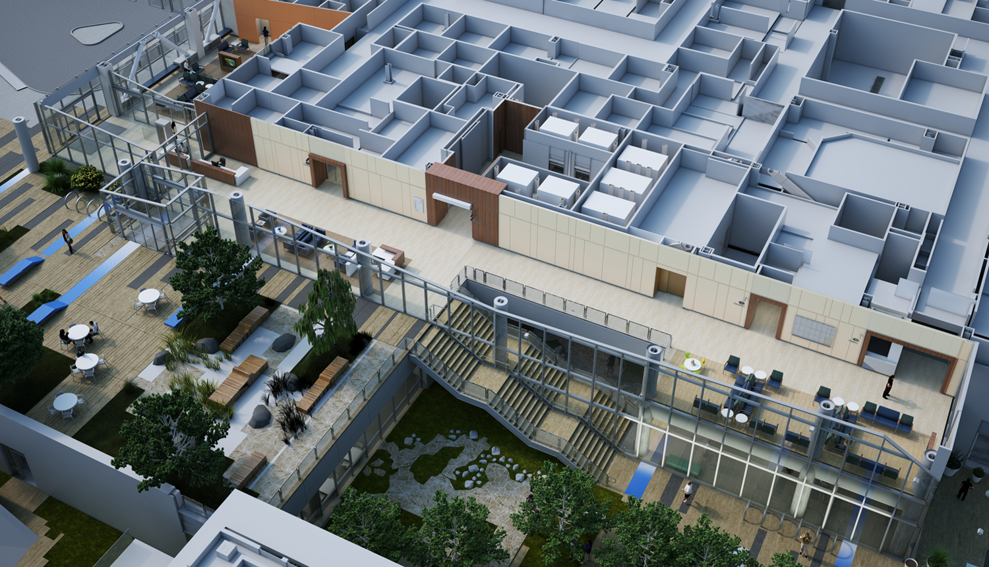
Entrance
(27th Street Emergency)
Emergency Dept
Imaging Dept
ED Waiting
Public Elevator
Security
Reception
Entrance
(Plaza- Main Lobby)
Plaza L2
Imaging Waiting
Plaza Courtyard
Entrance L1
(Cesar Chavez)
Notes:
Cutaway View of MBC

Slide 18
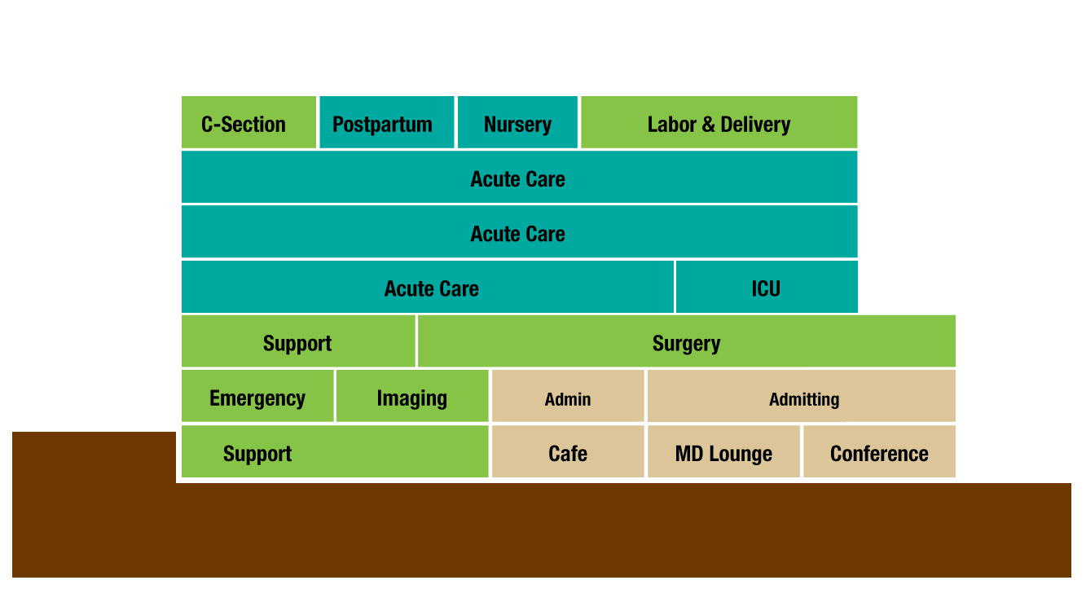
27th Street
Cesar
Chavez
Go to CPMC2020.org for Virtual Reality Views of Departments

Slide 19
Mission Bernal Auxiliary Buildings: I
Remain at 1912 Valencia
Breast Health
Chapel
Diabetes Center
EVS Offices
Remain at Monteagle / 1580 Valencia
Radiology
Lab Draw
MD Offices
Pharmacy
Specialty Clinics & HCC
Notes:
STL ONLY

Slide 20
Mission Bernal Auxiliary Buildings: II
Moving to 1912 Valencia
Admin
Care Coordination
MB Scheduling
Volunteer Office
Moving to Monteagle / 1580 Valencia
Engineering
Info Services
Interpreter Services
Newborn Connections Non-Invasive Cardiology
Moving to Hartzell Building (in 2019)
Admin
Antepartum Testing
Cardiac Rehab
Clinical Research
Engineering
Pulmonary Function Lab
Pulmonary Rehab
Notes:
STL ONLY

Slide 21



Episode Six: Smart Hospitals
with guests Hamila Kownacki, PAC OR & Radiology Staff
Notes:
• Having Smart hospitals was a key part of our planning for MB and VNG.
• Lets take a look at some of the great technologies we’ll have at the new hospitals

Slide 22
Care
Performance
Me
Community
Notes:
^{Importance of measuring} ^{how we are doing}
^{Investment in becoming a} ^{highly reliable organization}
^{Share, learn, reward}

Slide 23

Care
Performance
Me
Community
Handwashing is one of our three high reliability initiatives
full performance
85% compliance
threshold performance
75% compliance

Slide 24
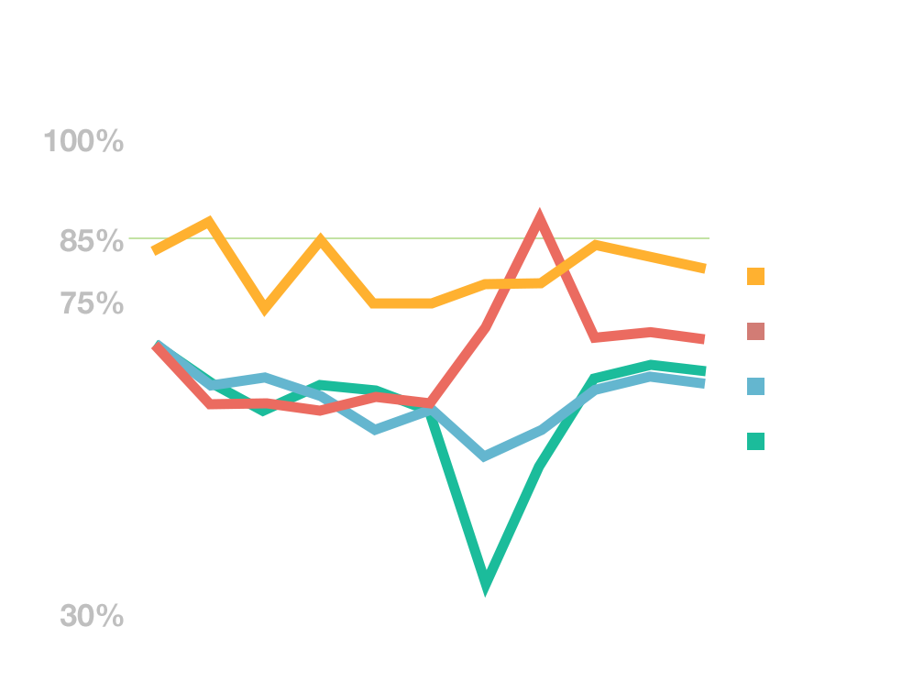
Handwashing
All CPMC Campuses
Congrats!
Best Results to Date

Slide 25
Employee Handwashing
average September 2017
St. Luke’s – SNF leads the way
SNF
ICU
Sub Acute
MedSurg 9th Fl
Telemetry 10th Fl
93%
90%
88%
84%
81%
Below Threshold
Threshold
Full

Slide 26

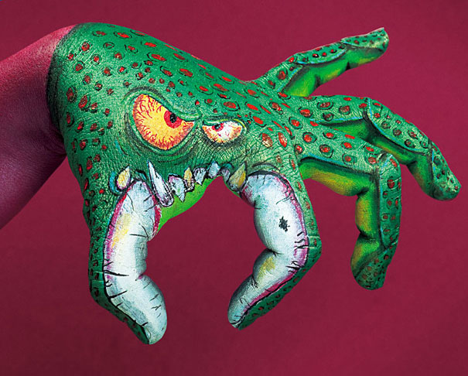

What can we do to continue our progress?
Notes:
Reference AeroScout

Slide 27

Financial Health
Affordability (n.)– within the financial means of most people… reasonable… accessible
How are we doing?
Notes:
What does affordability mean?
To Sutter Health
To CPMC
To our patients
Increasing Costs of Care, Co-pays, Insurance Premiums

Slide 28
Our Costs compared to Northern CA
Median CPMC

Slide 29
Cost of healthcare in the US
Median CPMC
Source: CMS.HHS.gov
Notes:
SOURCE : Centers for Medicare and Medicaid Services, Office of the Actuary, National Health Statistics Group
http://www.kff.org/report-section/health-care-costs-a-primer-2012-report/

Slide 30
Bending the Affordability Curve
Cost of Care
Think globally, but act locally.
Time

Slide 31
…and now for something lighter.
Notes:
Our affordability challenge. Let it sink in.
But now lets move to something lighter.

Slide 32

50 years ago…
Notes:
Ask Baby Boomers to raise their hands?
Some of us lived this – for others, it is a history quiz
No prizes- just the joy of being right

Slide 33

Notes:
Summer of Love CPMC late 60’s trivia (4 questions)

Slide 34

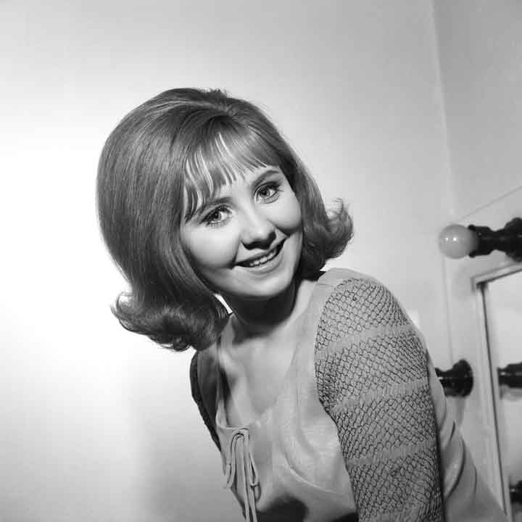
Which of the following songs was the #1 rock and roll hit of 1967?
Light my Fire (the Doors)
I’m a Believer (the Monkees)
Respect (Aretha Franklin)
To Sir with Love (Lulu)
Something Stupid (Frank & Nancy Sinatra)
Lulu
“To Sir, with Love”
Notes:
Need Audio.
The answer: To Sir with Love - the theme from a movie starring Sidney Poitier
All the others were in the top 13. (even “Something Stupid”)
Pict from movie and or music LULU
https://www.youtube.com/watch?v=yTapoA5RQyo 1:02

Slide 35
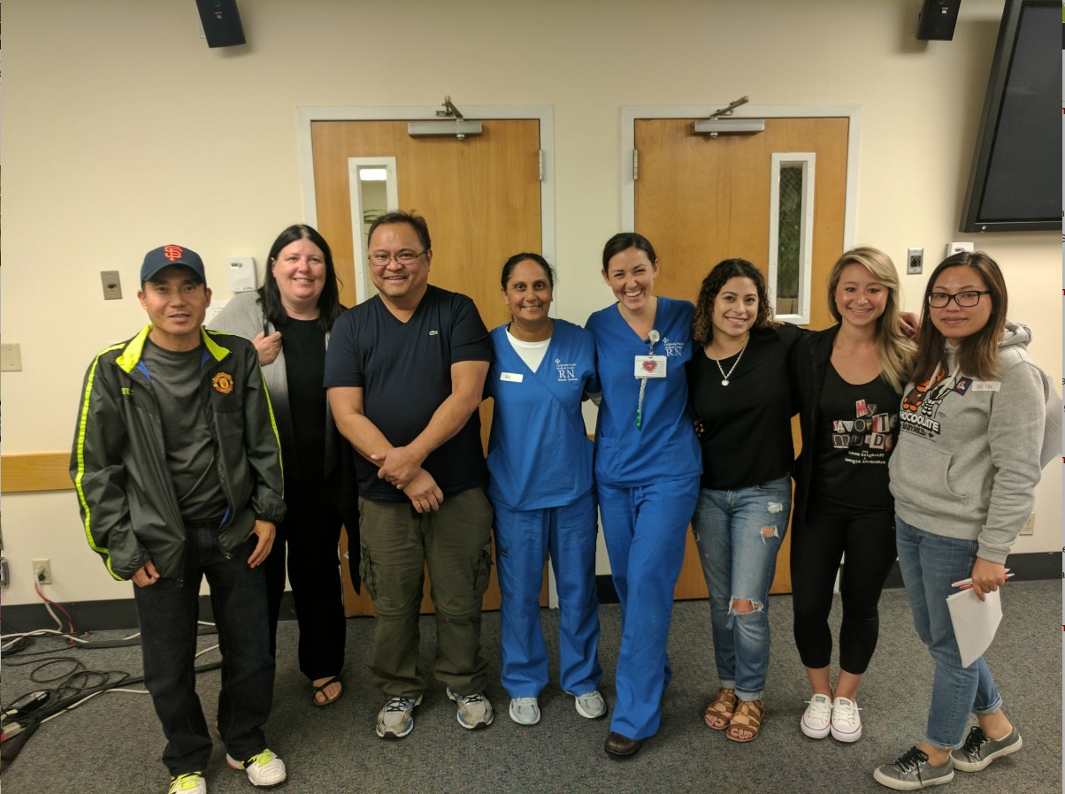
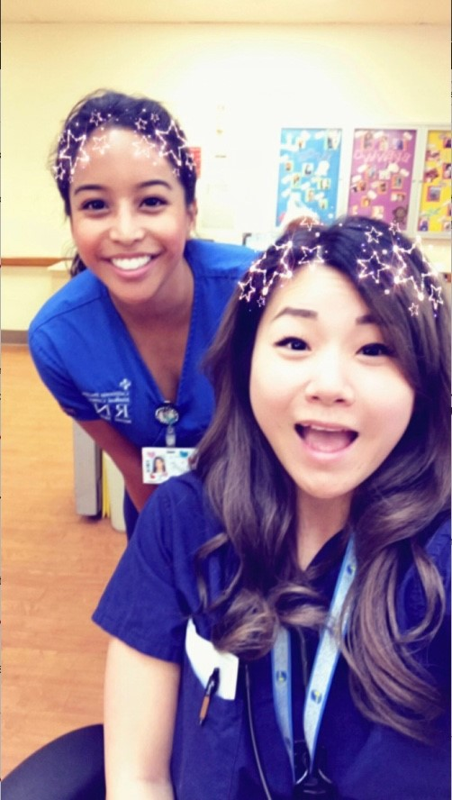
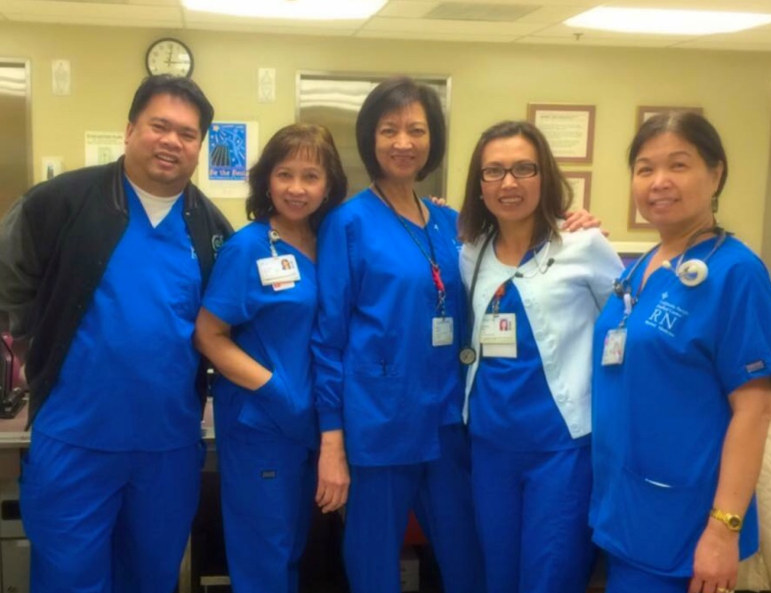
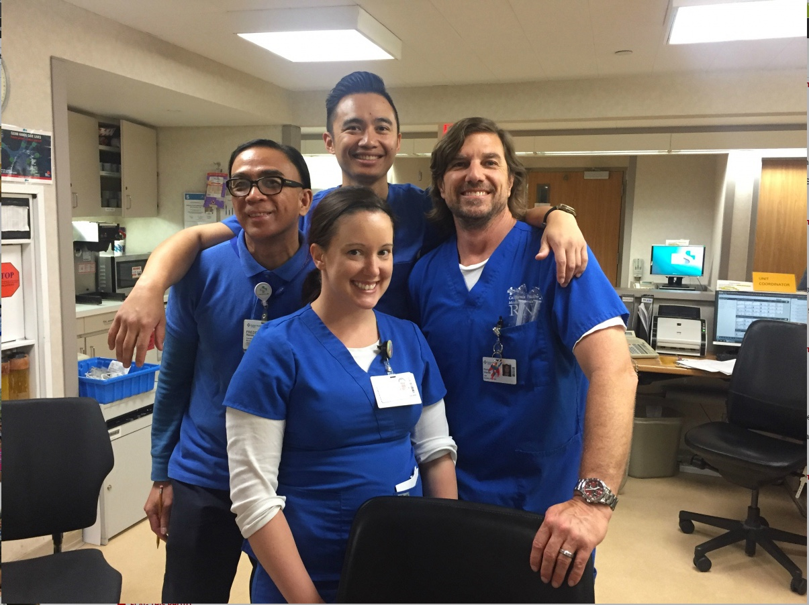
Care
Performance
Me
Community
Notes:
We are each an important and critical part of CPMC
A complex organization
Responsible to ourselves and our team for doing our best
Personal accountability

Slide 36

Your #1 (and #2) questions about the new hospitals:
How will I
get to work?
Where will I park?

Slide 37
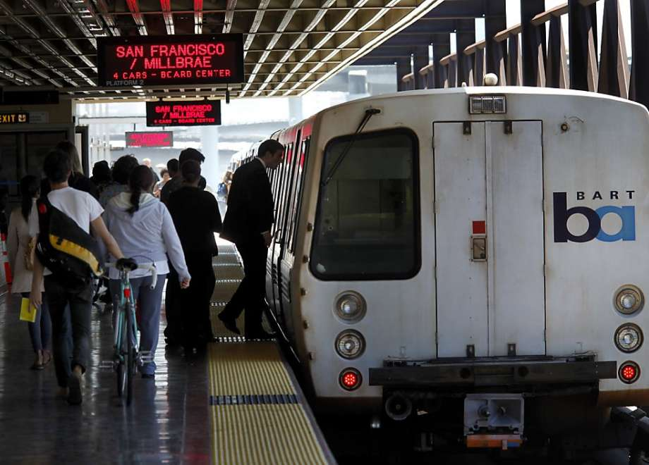

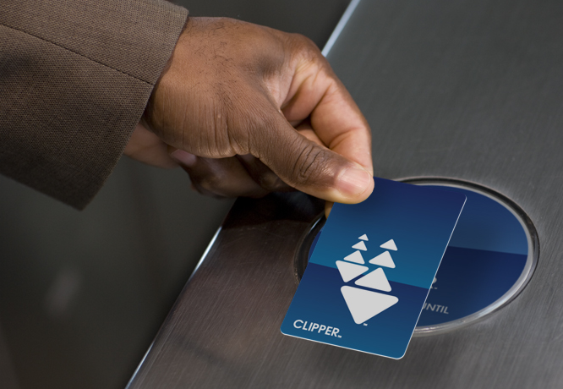
Our commitment to the City
Reduce the number of cars
Public transportation
Bike parking
Shuttles
Car pooling
Subsidies

Slide 38

How’s it looking now?
Employee Carpools
Cal: 20
Pac: 5
Davies: 4
SLH: 1
Notes:
August 2017 data
Carpool graphic

Slide 39
Notes:
Includes Clipper Cards

Slide 40

What can you do right now?
Start using van pools
Use public transportation
Go online to: www.wework.org (for subsidies)

Slide 41
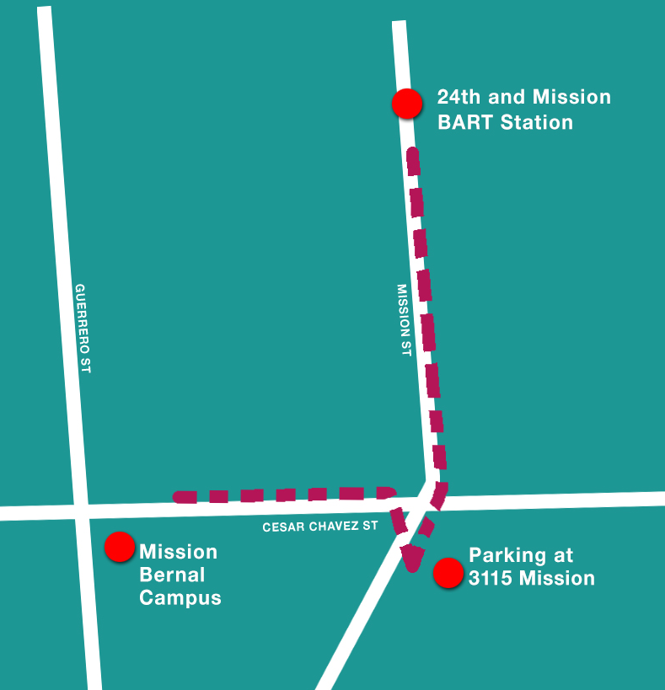
Starting Feb 2018: New Shuttle Mission Bernal to and from 24th St. BART
Every 30 minutes
6am – 6pm
Also picks up from off-campus parking lot at 3115 Mission St.
Notes:
Just for St Lukes Town Hall

Slide 42
Where will I park?
Existing campus garage
including evening and night shift
New: 3115 Mission St. (Construction Site Parking Lot)
60 spaces
4 minute walk from campus
Business Hours Only (for safety)
Notes:
Only for St. Lukes Town Hall

Slide 43


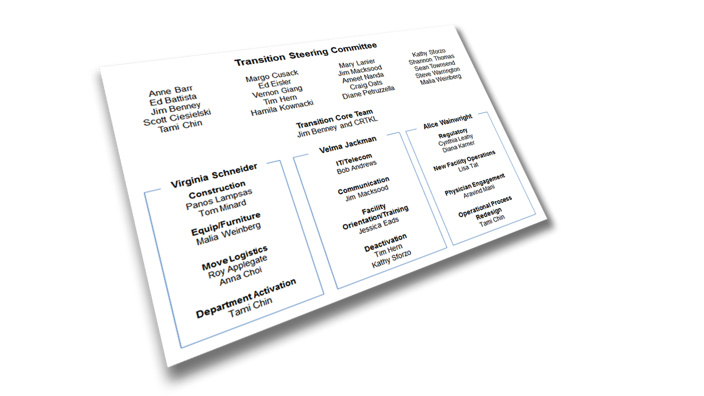
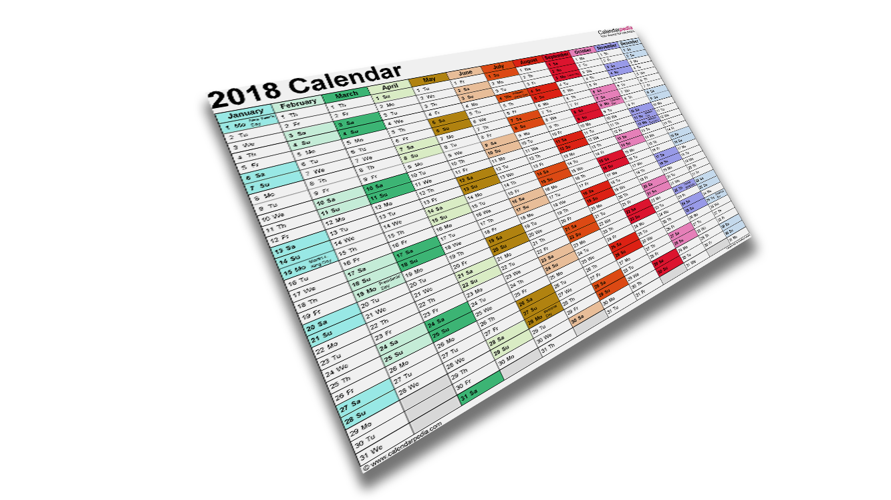
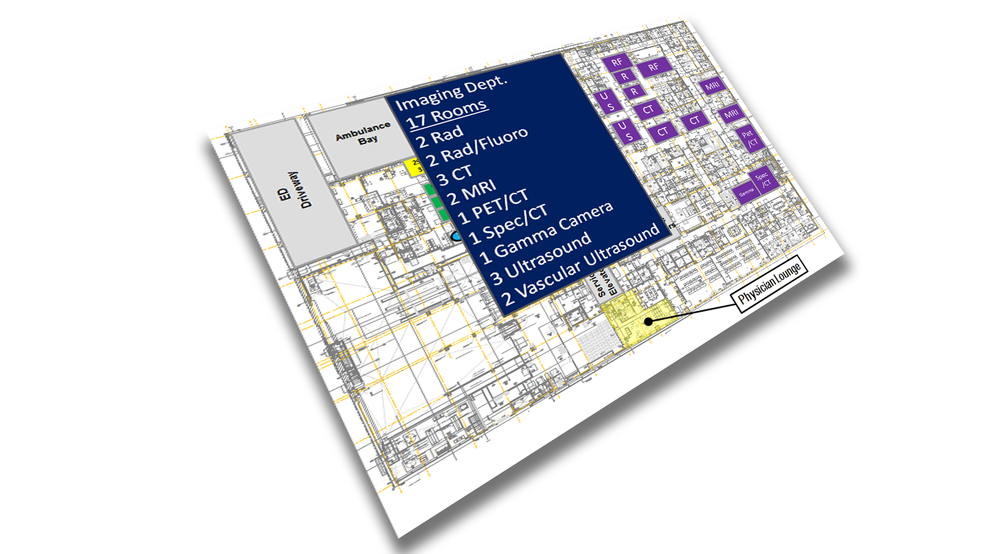

The transition is
complicated.
Notes:
These hospital moves are complicated.
Imagine, moving hundreds of pieces of equipment, getting the supplies stocked, orienting everyone to the new buildings, and then moving staff and patients – all without interruption in patient care
Our primary responsibility is to make sure the moves are as smooth as possible and that we are ready to go.
So, we’re not cramming it all in over a short period of time, but being very thoughtful and systematic

Slide 44
Just to give you an idea…
1,575
milestones
238
action items
(and counting)
332
900
existing technical applications to install
budget line items
90
new applications to install

Slide 45
Transition Steering Committee
Anne Barr
Ed Battista
Jim Benney
Scott Ciesielski
Tami Chin
Margo Cusack
Ed Eisler
Vernon Giang
Tim Hern
Hamila Kownacki
Mary Lanier
Jim Macksood
Ameet Nanda
Craig Oats
Diane Petruzzella
Kathy Sforzo
Shannon Thomas
Sean Townsend
Steve Warrington
Malia Weinberg
Transition Core Team
Jim Benney and consulting firm
Virginia Schneider
Velma Jackman
Alice Wainwright
Construction
Panos Lampsas
Tom Minard
IT/Telecom
Bob Andrews
Regulatory
Cynthia Leahy
Diana Karner
Communication
Jim Macksood
New Facility Operations
Lisa Tat
Equip/Furniture
Malia Weinberg
Facility Orientation/Training
Jessica Eads
Move Logistics
Roy Applegate
Anna Choi
Physician Engagement
Aravind Mani
Department Activation
Tami Chin
Deactivation
Tim Hern
Kathy Sforzo
Operational Process Redesign
Tami Chin
Notes:
So, how are we making all of this happen?
12 different Focus Groups that have been meeting at least monthly
Focus group leaders are meeting together 2x/mth to share and collaborate
Plus, an overall Steering Committee to make sure all on target

Slide 46

Mission Bernal Transition Schedule
Completed — Spring 2017
Occupancy planning meetings with departments (40)
Support Departments planning meetings (14)
Notes:
Here’s what we’re looking at for the M-B move and training schedule
There will be training for everyone who is moving to one of the new hospitals on entrances, badging, elevators, safety, lockers and other employee services
Also, clinical training – in unit, work with lifts, other technologies
And department-specific training
We don’t yet have exact dates, but will keep you posted.
So, stay tuned!

Slide 47
Mission Bernal Transition Schedule
Now – End of 2017
Medical equipment and signage validation
Move Logistics meetings with departments (28)
Begin Clinical and Move Day meetings with departments
Art selection
All hospital processes re-design completed (Dec.)

Slide 48






Mission Bernal Transition Schedule
2018
May
Install equipment, electronics & furniture
June
Clinical and Move Day meetings completed (52) Project Team turns building over
June – August
Staff and Stock
Includes general hospital/clinical training (est. 8 hour each) & department-specific (est 8–40 hours)

Slide 49
Transition Timeline
PTO Reminder: All Campuses
2017
2018
2019
2020
For Pac/Cal Move Mar. 2019
For St. Luke’s Move August 2018
For Pac/Cal Move Nov. 2018—Mar. 2019
For St. Luke’s Move June—August 2018
MB
STL
PAC
Some Departments will need VP approval for PTO:
2 weeks before move, these groups also need VP approval
VN
CAL
Parking Services
Residents
GME Office
Human Resources
OP Clinics
Diabetes Center
Infusion Services
Radiation Oncology
EEG / Neurosciences
Quality/Infection Control
Risk Management
Interpreter Services
Research
Pastoral Care
IHH
IP Nursing (inc. NPs, CNS, Educators)
Care Coordination
CCL/IR/EP/GI/IES
Surgical Services
Respiratory Therapy/Pulmonary
Pharmacy
Lab/Pathology
Diagnostic Imaging
Cardiology
PT/OT/SP
Food & Nutrition Services
EVS
Transport
Supply Chain
Plant Operations
Biomedical Engineering
Security
Safety
IT and PBX
Patient Access
Newborn Connection
VN MOB
PAC O/P
PAC
CAL O/P
MB
DAV
Notes:
Remember this slide. I want to call your attention to these little chunks of time.
Usual practice, scheduled PTO requires approval from your manager.
For the St. Luke’s move, approvals must be given by your VP, so talk to your manager.
This is for all campuses not just St. Luke’s
Why?
Its about having a safe move
We need to make sure we do not have “10 people out at the same time”
Some staff from other campuses will take on work at St. Luke’s while the St. Luke’s staff are moving.

Slide 50
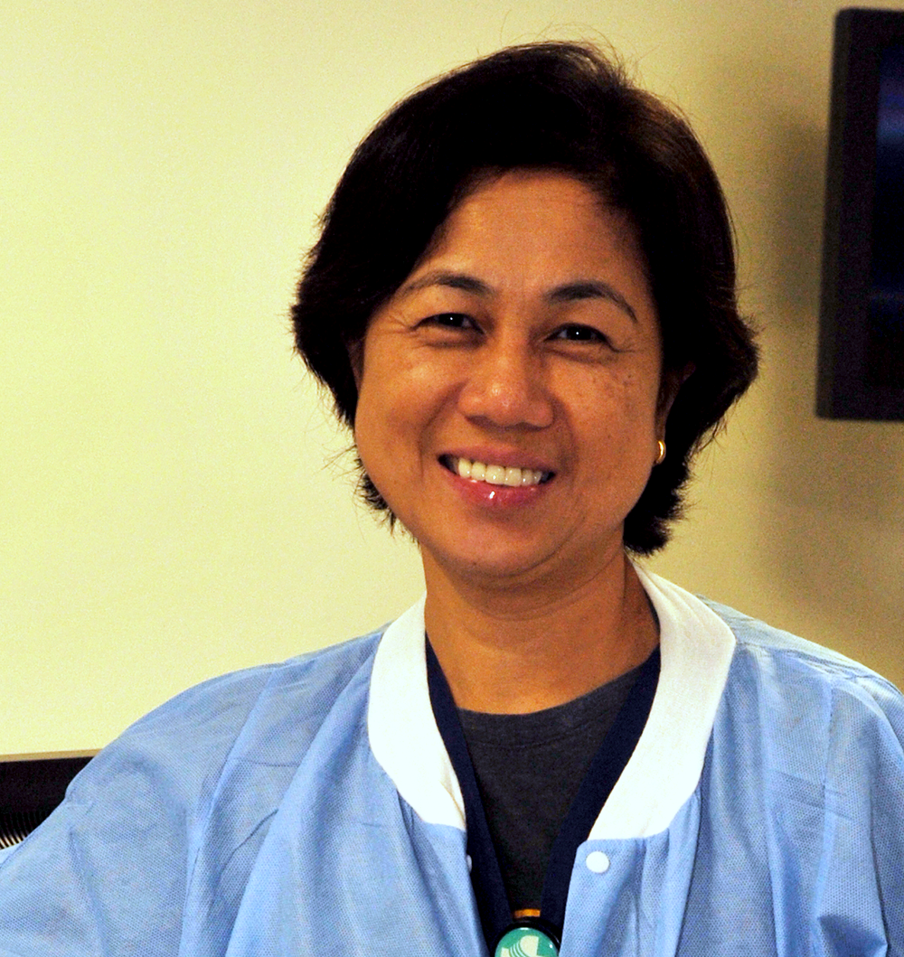
Delia Volante, RN
And now let’s take a moment to recognize one of our star employees…
And now, we want to take this time to recognize one of our own…
Charge Nurse
St. Luke’s OR
Notes:
STL
Here’s what Daniel Piechocinski, her supervisor, says about Delia.
“Delia, who has been with St Luke’s for 11 years, assumed the role of change nurse a few years ago, and has played a critical role in the day –to-day operations of the OR.
She is an invaluable resource to her colleagues and is one of the best nurses I have ever had the pleasure of work with.
Her care and compassion for her work and her patients is obvious every day. She is well respected by her peers, by leadership, and by physicians because of the amount of effort and energy she puts into her work.
She is always willing to go above and beyond the call of duty. I look forward to working with her for years to come!”

Slide 51
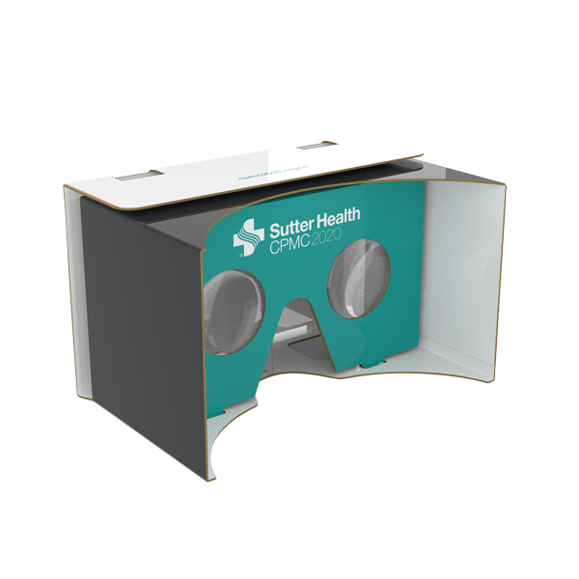
Reminder
Look for new VR Photos on the intranet
Submit your stories and photos for the Transition Keepsake

Slide 52


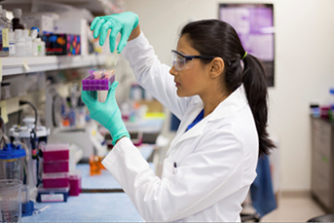
Our investment in the community
Care
Performance
Community
Care
Performance
Me
Community

Slide 53
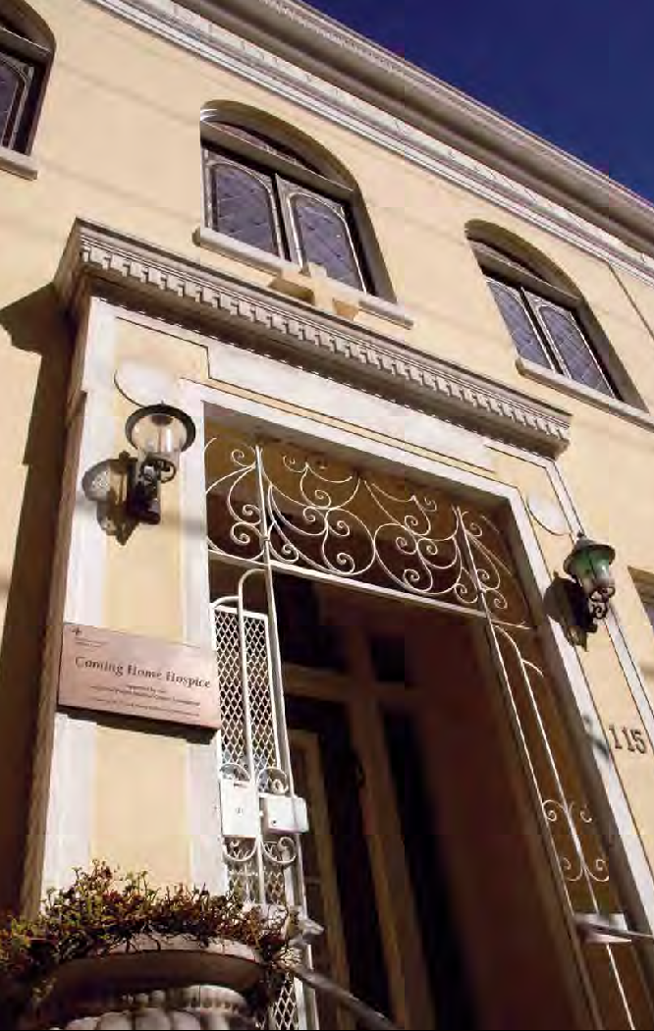
Coming Home Hospice
A 15-bed residential hospice located in the Castro district
Began as an AIDS hospice
Has provided end-of-life care to about 3,500 people since 1987
A part of CPMC since its beginning
CPMC Foundation partners with Coming Home Hospice to raise funds so all patients can access services, regardless of ability to pay
Notes:
As one of CPMC’s Community Benefit programs, this is one of the contributions we make to the communities we serve, as part of our non-profit, tax-exempt status.
End-of-life care is an important part of what we do – throughout CPMC – and that we can and do make it easier for families
Began as an AIDS hospice – first of its kind in the US
The hospice is a department of CPMC; CPMC developed the hospice in collaboration with the AIDS patient advocacy community and the Catholic Church, which donated the use of a former convent
Over half of patients are on a sliding fee scale, and we work with our partners to offer additional financial assistance
CPMCF’s support is critical to the hospice’s sustainability – makes up the difference between cost of care and what patients can pay
Between CPMC Foundation and CPMC Operations, we contribute just over a million dollars each year to provide this vital service to our community

Slide 54
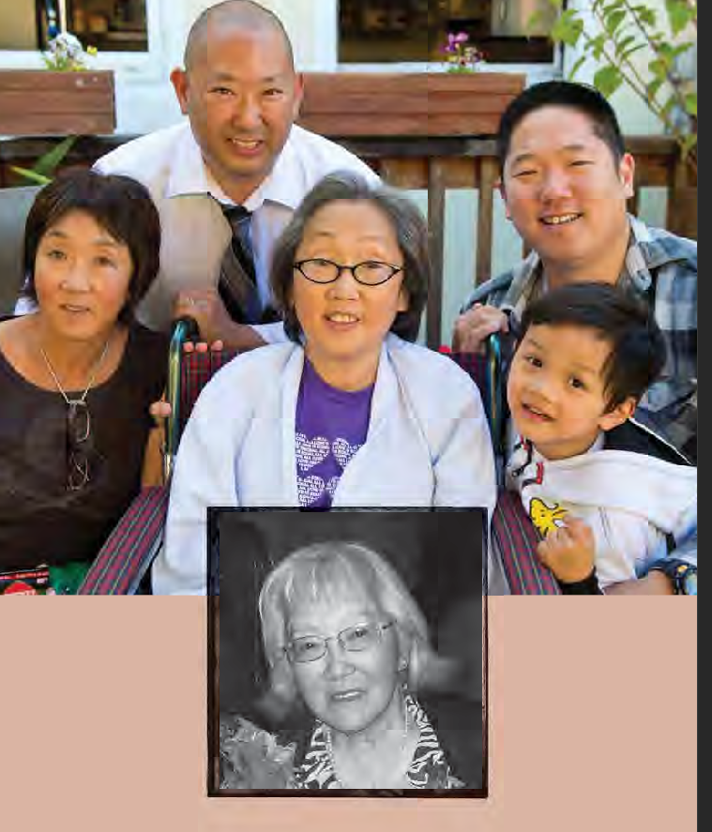
The Nakanishi Family’s Story
“The care here is genuine, really from the heart. We are amazed there is still a place like this in today’s world.”
Rod & Stuart Nakanishi, sons and brothers
Notes:
(to be read while slide is up Print separate Large)
Coming Home Hospice played an important role in the Nakanishi Family.
First, their mother became a patient.
When their mother Sachiko was a patient there, her daughter Cynthia learned that she had her own late stage cancer and said, “I am going to live my last days at Coming Home.” Cynthia is the woman in the photo in a wheelchair.
Here is what Rod and Stuart, Sachiko’s sons and Cynthia’s brothers, said about Coming Home Hospice:
“This is not a fancy place. What struck us after a thorough search for care providers for our mother – and now our sister – is that the care here is genuine, really from the heart. This is what is most important to us.
“It is also a place that allows us to process all the emotions of grief – denial, depression, anger, sadness. Nothing is left unsaid.
“Coming Home Hospice is a jewel in the city for this kind of care. To work here, one must have an appreciation, an enjoyment, of life. Like when we were born – natural and loving to everything. The people here still have those qualities – goodness, sincerity, and a giving attitude.
“We are amazed there is still a place like this in today’s world. They help make the last days enjoyable, for the patients and their families.”
Rod is now a volunteer at Coming Home Hospice.

Slide 55


Questions?

Slide 56
Drawings! Evaluation Form …and thank you!

